Slide 1
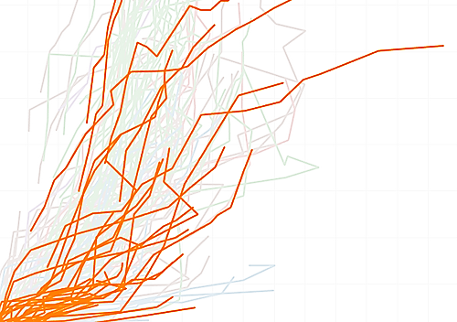
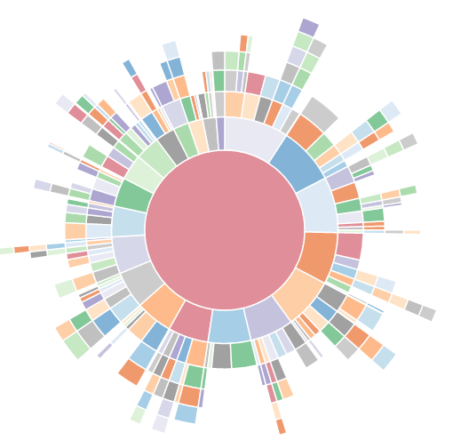
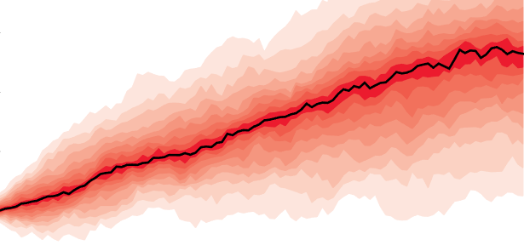
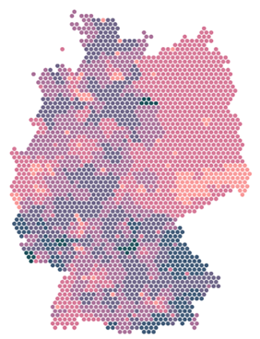
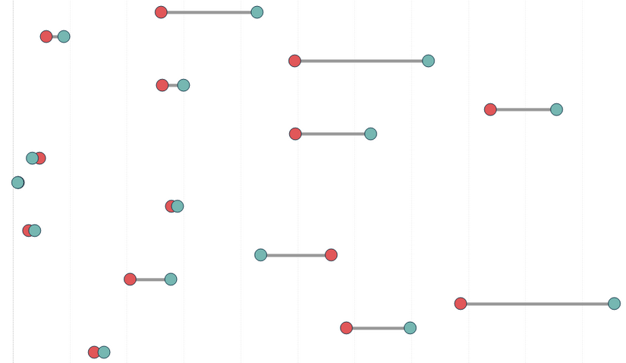
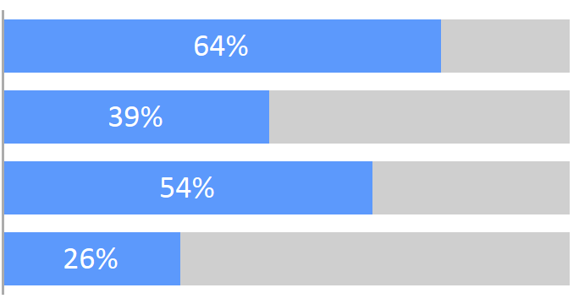
Lesson 8
Visualizations - I
Kush Kulshrestha

Slide 2
“Most of us need to listen to the music to understand how beautiful it is. But often that’s how we present statistics: we just show the notes, we don’t play the music.”
- Hans Rosling
“You can have piles of facts and still fail to resonate. Its not the information itself that is important but the emotional part of that information.”
- Nancy Duarte

Slide 3
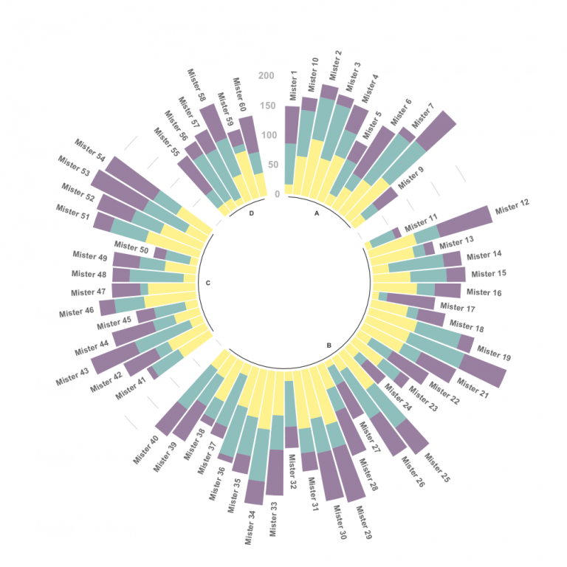
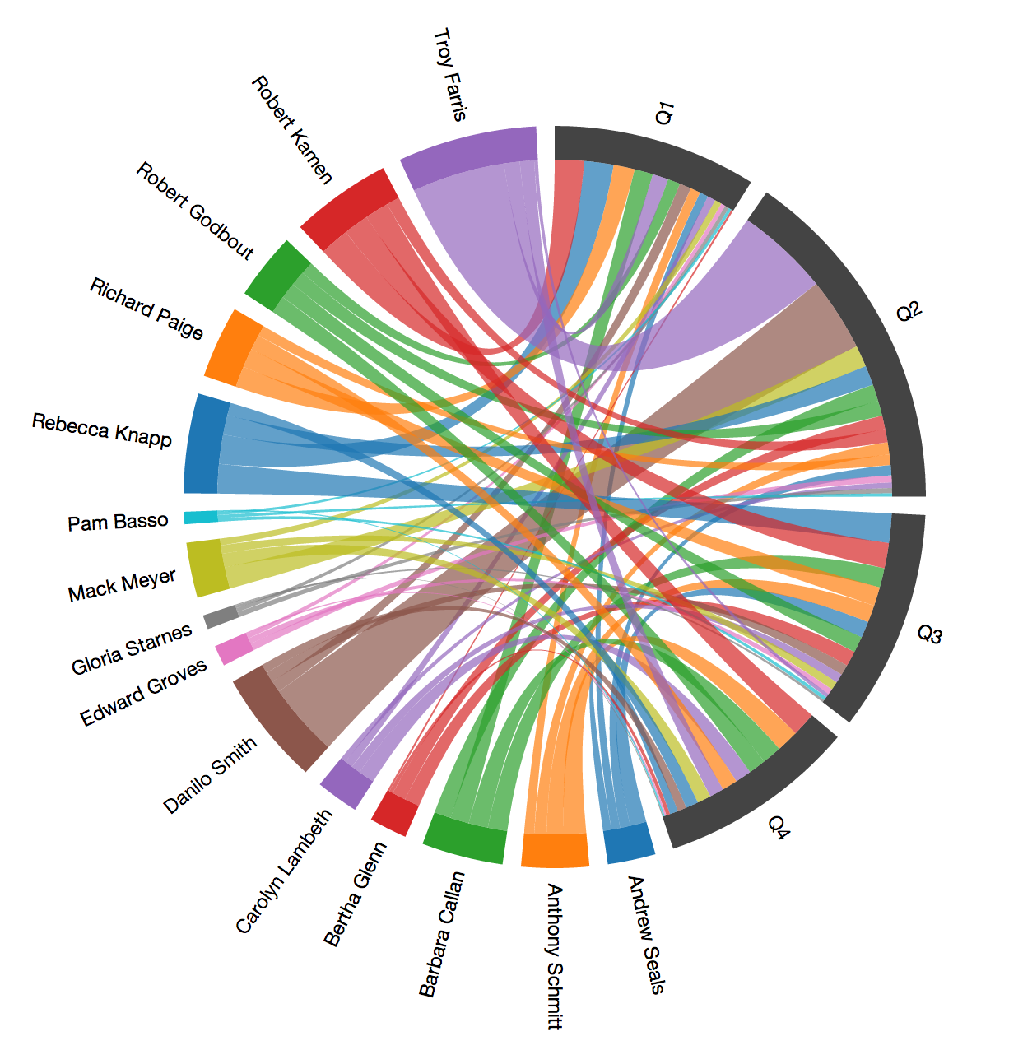
What people think Visualization is…

Slide 4
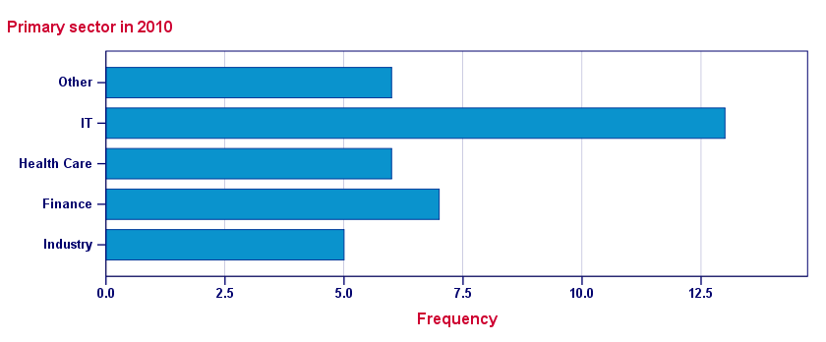
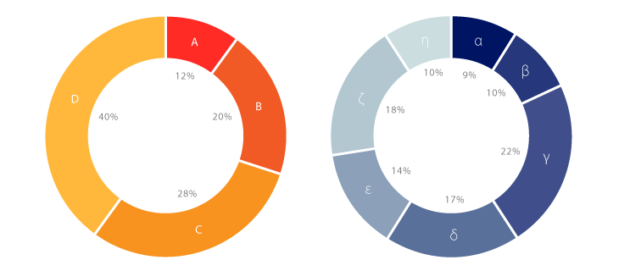
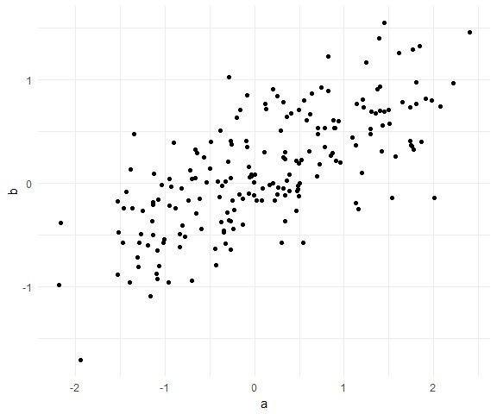
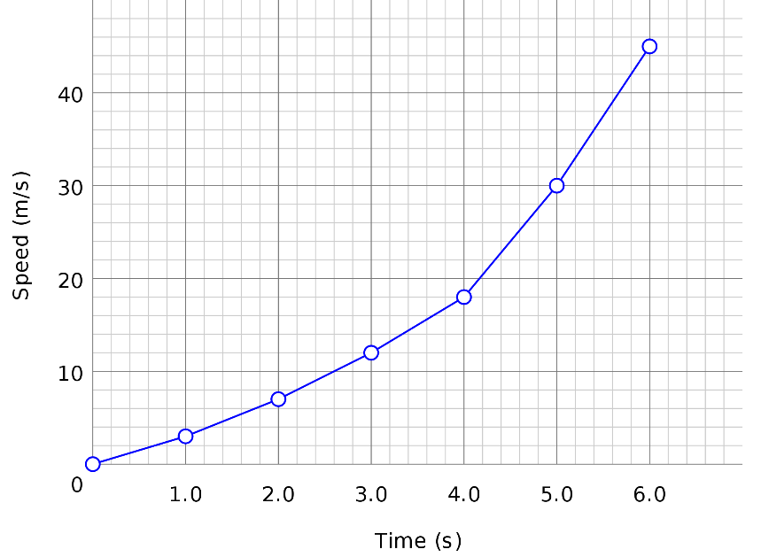
What Visualization is…
+
Some Rules

Slide 5
data visualization
the visual representation of data
a primary goal of data visualization is to communicate information clearly and efficiently to users via the statistical graphics, plots, information graphics, tables, and charts selected
the purpose of visualization is insight, not pictures

Slide 6
Types of Graphs

